Slide 1

Presentation Materials Created by Mimetics Inc.
Free use by anyone for non-commercial purposes
Copyrights, Trademarks and other Registered Marks the Property of their Owners

Slide 2
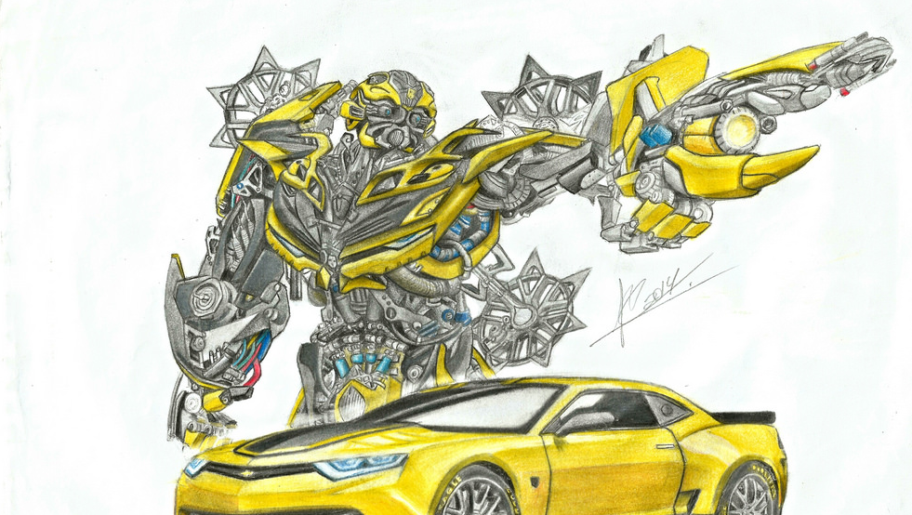
Grade 6 - Class 5 – Robot Drawing
Notes:
We want to introduce the Jade Robot and it’s Tools in more detail along with our action plans for it.
It’s interesting, but it’s easy to criticize something when it’s done (especially when you have experience) – a *LOT* more difficult getting it right from the start. Also, preparing this presentation was a great way to review and think about what we should be doing.

Slide 3
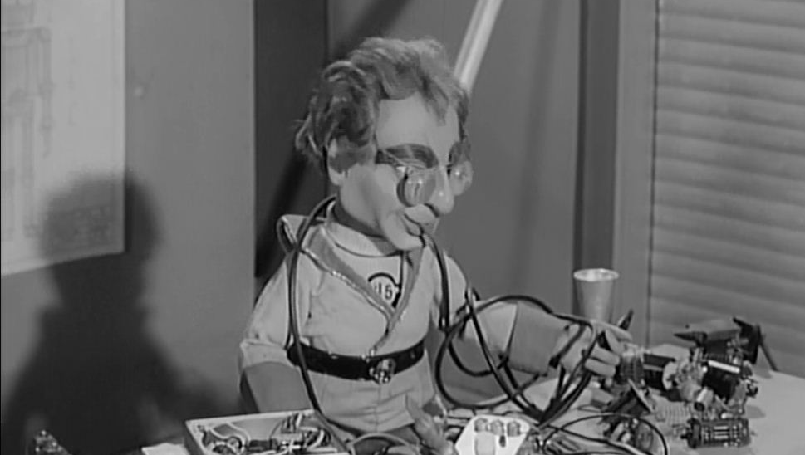
Rule One
Robots Run on the Floor
Notes:
Can Demo Jade Scratch if people are interested. In doing this product I’ve had a few interesting discoveries – one was going with a simpler programming language actually has a *LOT* of value for an expert like myself.

Slide 4
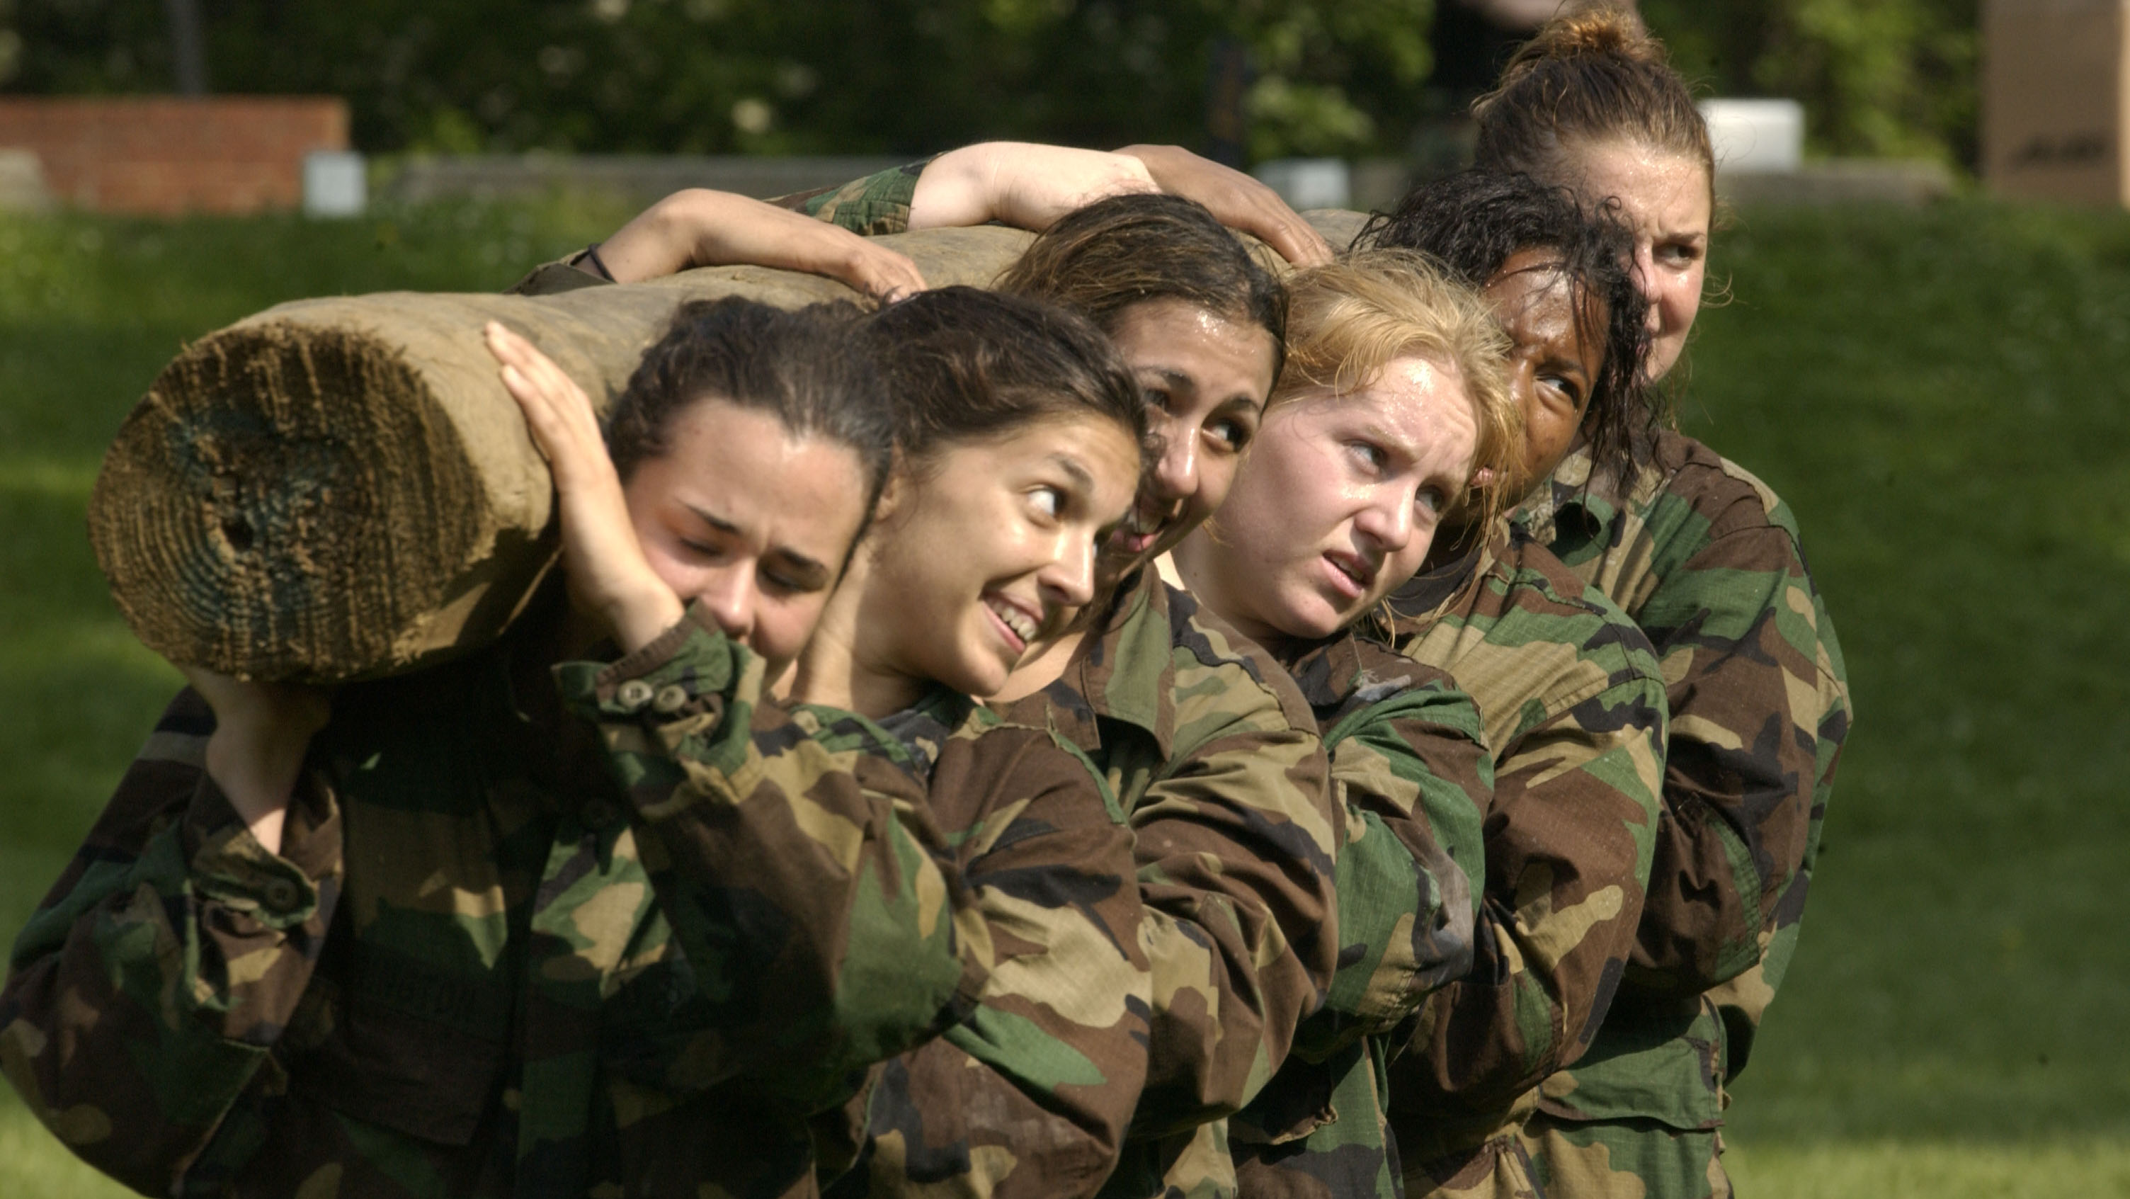
Rule Two
We ALL Stay Together
Notes:
Can Demo Jade Scratch if people are interested. In doing this product I’ve had a few interesting discoveries – one was going with a simpler programming language actually has a *LOT* of value for an expert like myself.

Slide 5
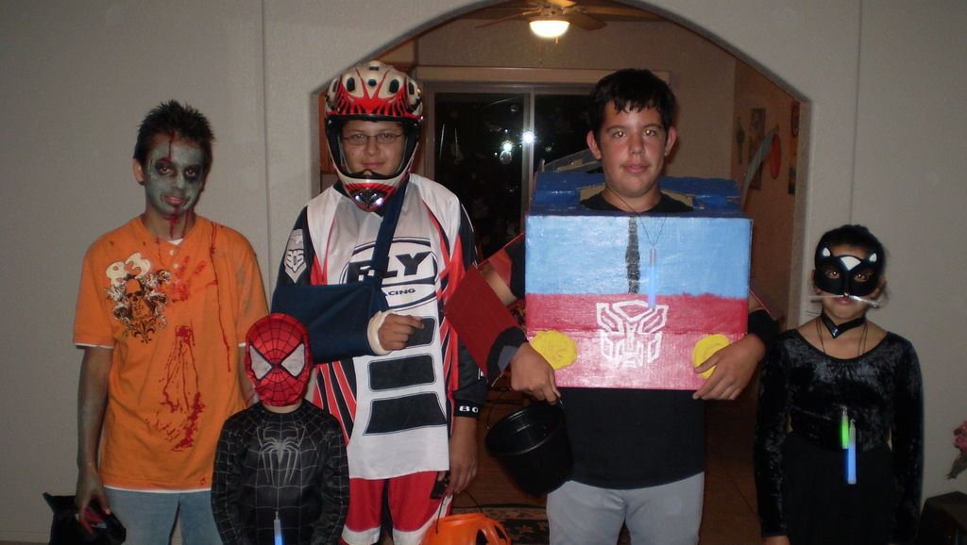
Hint for Copying
Programs…
Notes:
Can Demo Jade Scratch if people are interested. In doing this product I’ve had a few interesting discoveries – one was going with a simpler programming language actually has a *LOT* of value for an expert like myself.

Slide 6
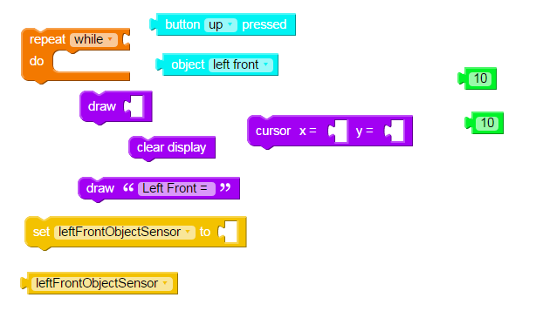
Hint for Copying…
DON’T Load Blocks First
Copy Program in Order
Notes:
Can Demo Jade Scratch if people are interested. In doing this product I’ve had a few interesting discoveries – one was going with a simpler programming language actually has a *LOT* of value for an expert like myself.

Slide 7
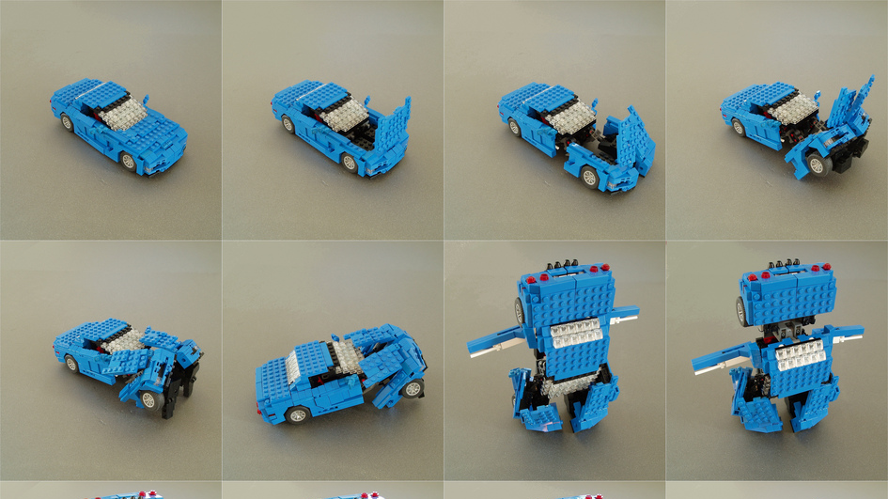
ALWAYS Think in Terms of SEQUENCE!
Notes:
Can Demo Jade Scratch if people are interested. In doing this product I’ve had a few interesting discoveries – one was going with a simpler programming language actually has a *LOT* of value for an expert like myself.

Slide 8
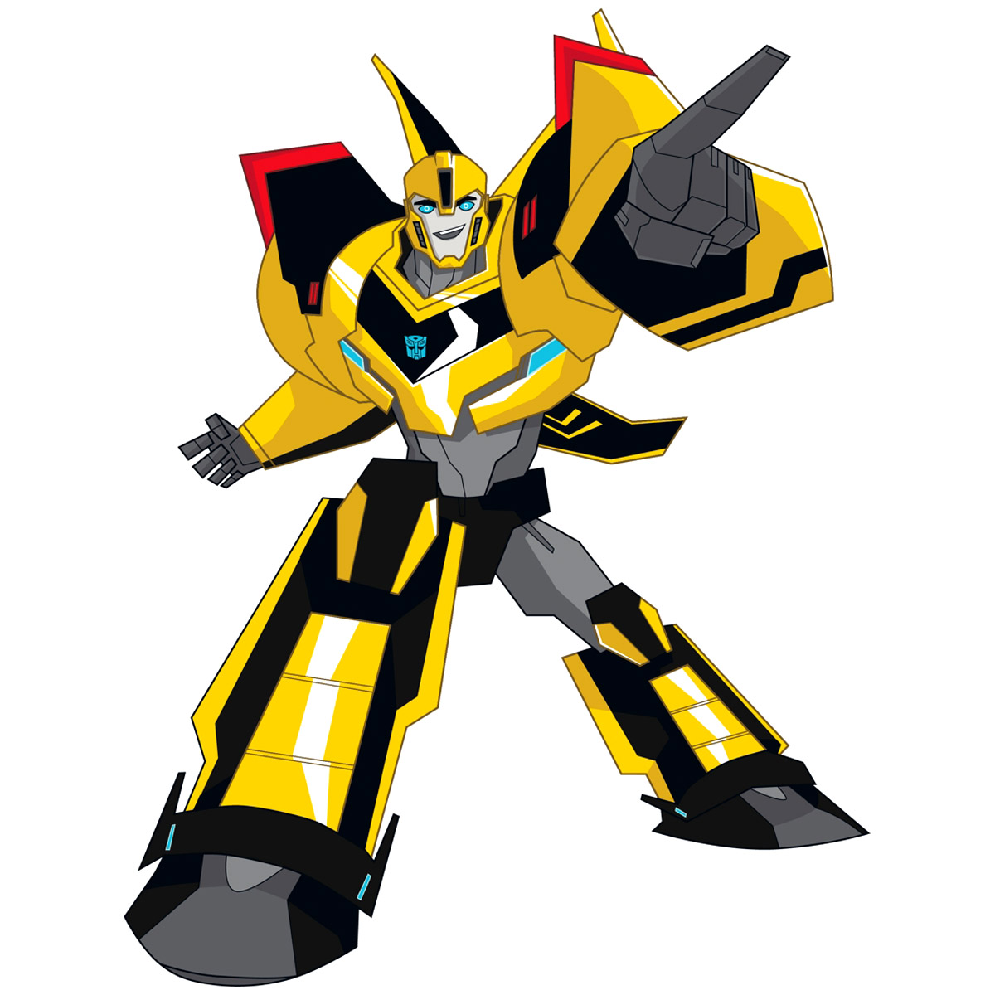
Recap
What is Programming?
How many milliseconds are there in a second?
Which Direction does the Right Track turn when the Robot Turns Right?
Notes:
Can Demo Jade Scratch if people are interested. In doing this product I’ve had a few interesting discoveries – one was going with a simpler programming language actually has a *LOT* of value for an expert like myself.

Slide 9
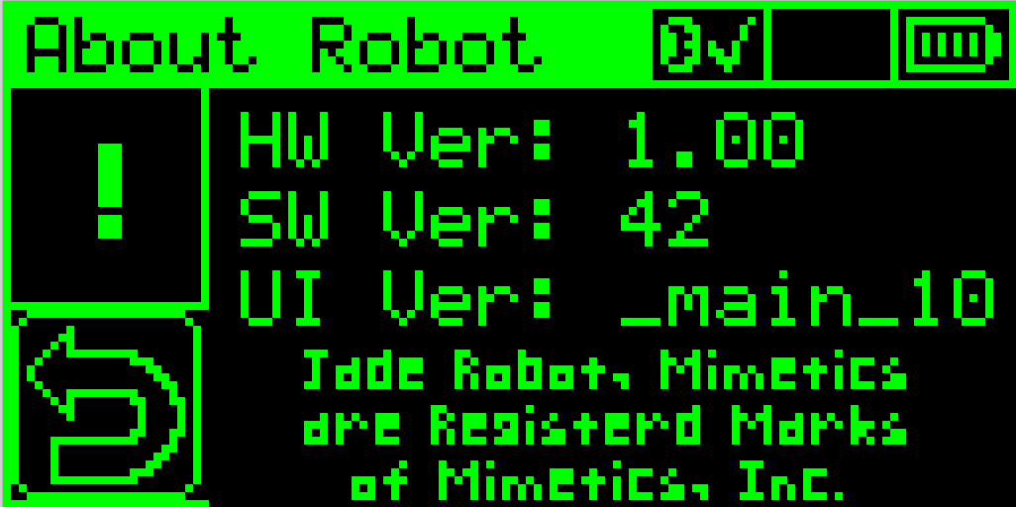
OLED Display
Origin (0,0)
End (127, 63)
Notes:
Can Demo Jade Scratch if people are interested. In doing this product I’ve had a few interesting discoveries – one was going with a simpler programming language actually has a *LOT* of value for an expert like myself.

Slide 10
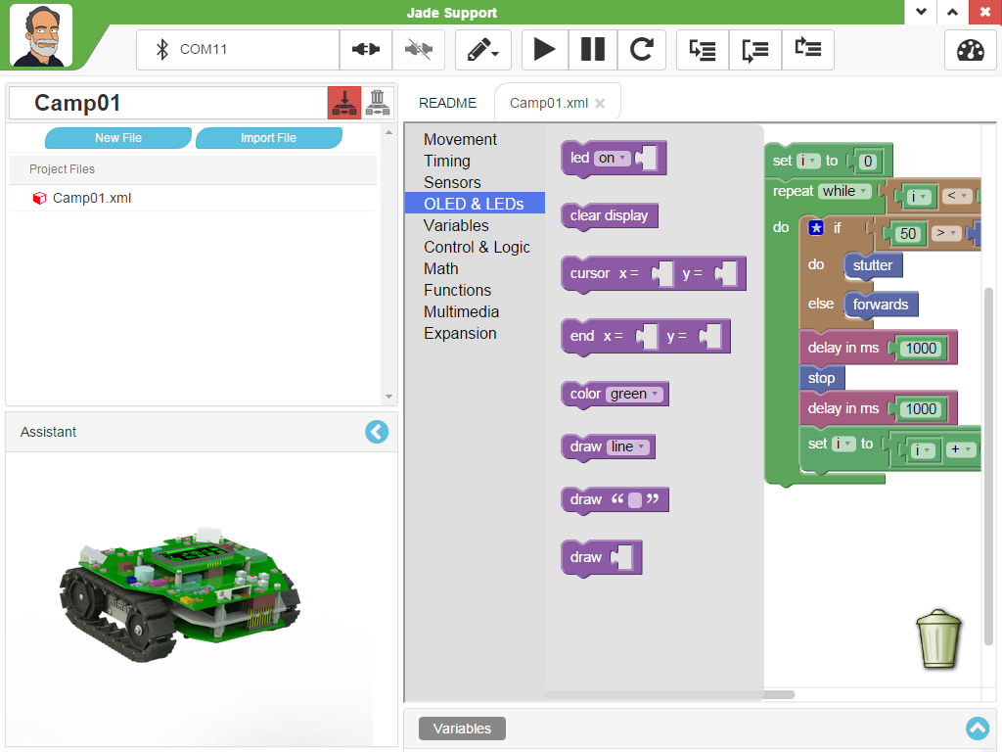
LED & OLED Status Updates Blocks
LED On/Off/Flash – LEDs 0 - 5
Clear OLED Display
Set Position of Next “draw”
“draw” Text String, Cursor Updated
“draw” Integer, Cursor Updated
Notes:
Can Demo Jade Scratch if people are interested. In doing this product I’ve had a few interesting discoveries – one was going with a simpler programming language actually has a *LOT* of value for an expert like myself.

Slide 11
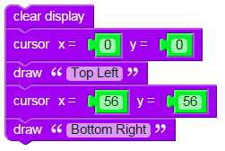
“DrawOut2”
Notes:
Can Demo Jade Scratch if people are interested. In doing this product I’ve had a few interesting discoveries – one was going with a simpler programming language actually has a *LOT* of value for an expert like myself.

Slide 12
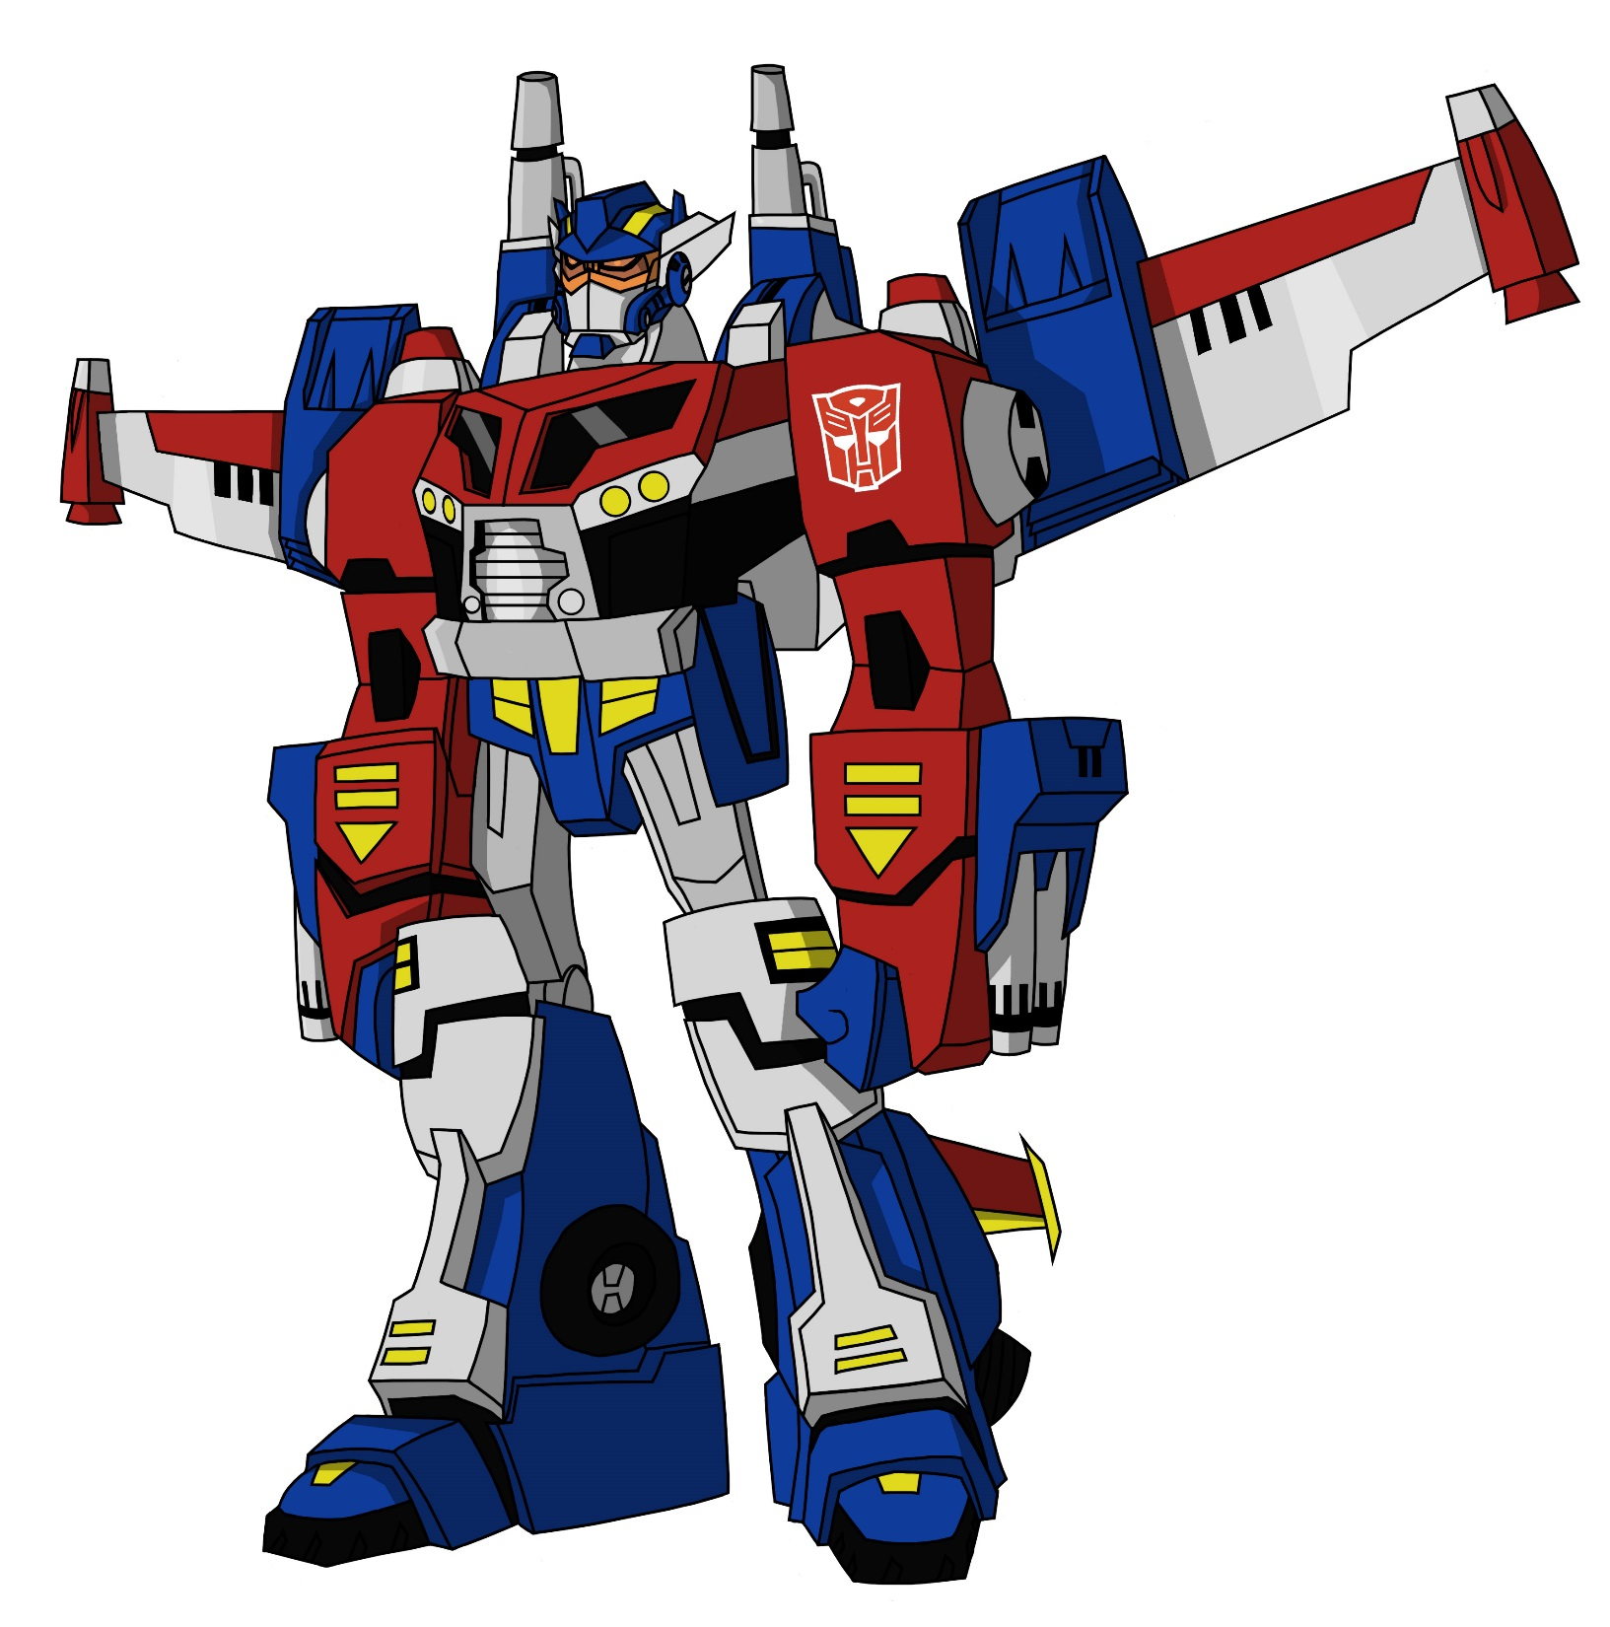
Character Blocks
8 Pixels High
6 Pixels Wide
Notes:
Can Demo Jade Scratch if people are interested. In doing this product I’ve had a few interesting discoveries – one was going with a simpler programming language actually has a *LOT* of value for an expert like myself.

Slide 13
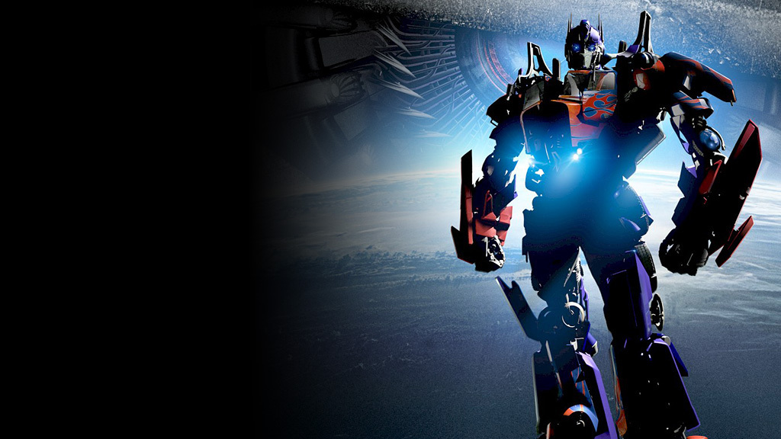
What does a Line Need?
Notes:
Can Demo Jade Scratch if people are interested. In doing this product I’ve had a few interesting discoveries – one was going with a simpler programming language actually has a *LOT* of value for an expert like myself.

Slide 14
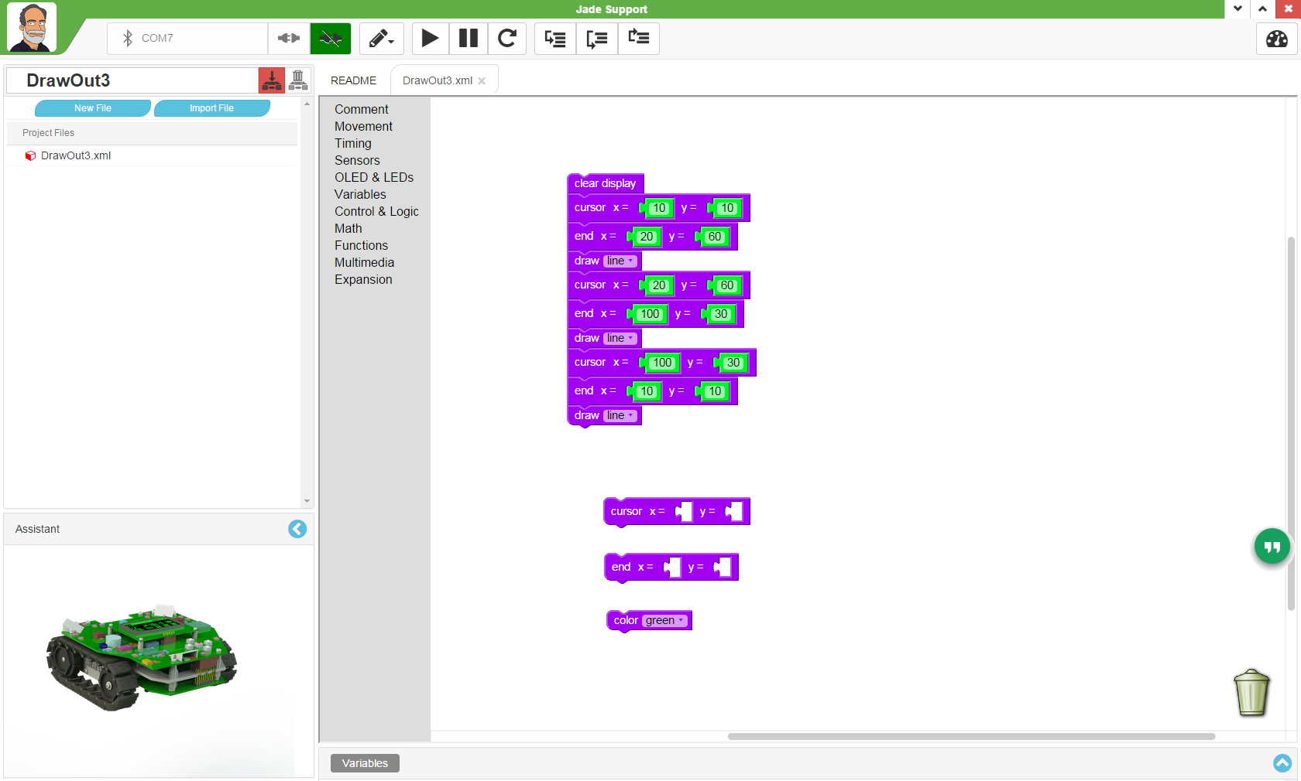
What does a Line Need?
Start Position
End Position
Colour
Notes:
Can Demo Jade Scratch if people are interested. In doing this product I’ve had a few interesting discoveries – one was going with a simpler programming language actually has a *LOT* of value for an expert like myself.

Slide 15
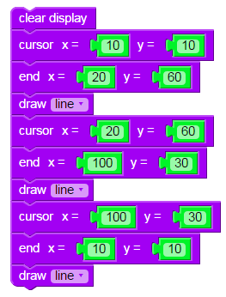
“DrawOut3”
Default Colour is “Green”
After Coordinates are set,
Draw “line”
Notes:
Can Demo Jade Scratch if people are interested. In doing this product I’ve had a few interesting discoveries – one was going with a simpler programming language actually has a *LOT* of value for an expert like myself.

Slide 16
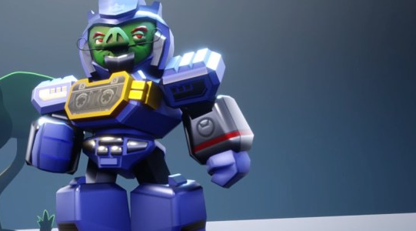
A Rectangle Requires
Top Left Position
Bottom Right
Colour
Notes:
Can Demo Jade Scratch if people are interested. In doing this product I’ve had a few interesting discoveries – one was going with a simpler programming language actually has a *LOT* of value for an expert like myself.

Slide 17
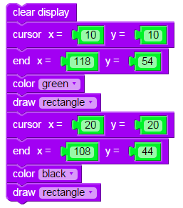
“DrawOut4”
Default Colour is “Green”
After Coordinates are set,
Draw “rectangle”
Notes:
Can Demo Jade Scratch if people are interested. In doing this product I’ve had a few interesting discoveries – one was going with a simpler programming language actually has a *LOT* of value for an expert like myself.

Slide 18
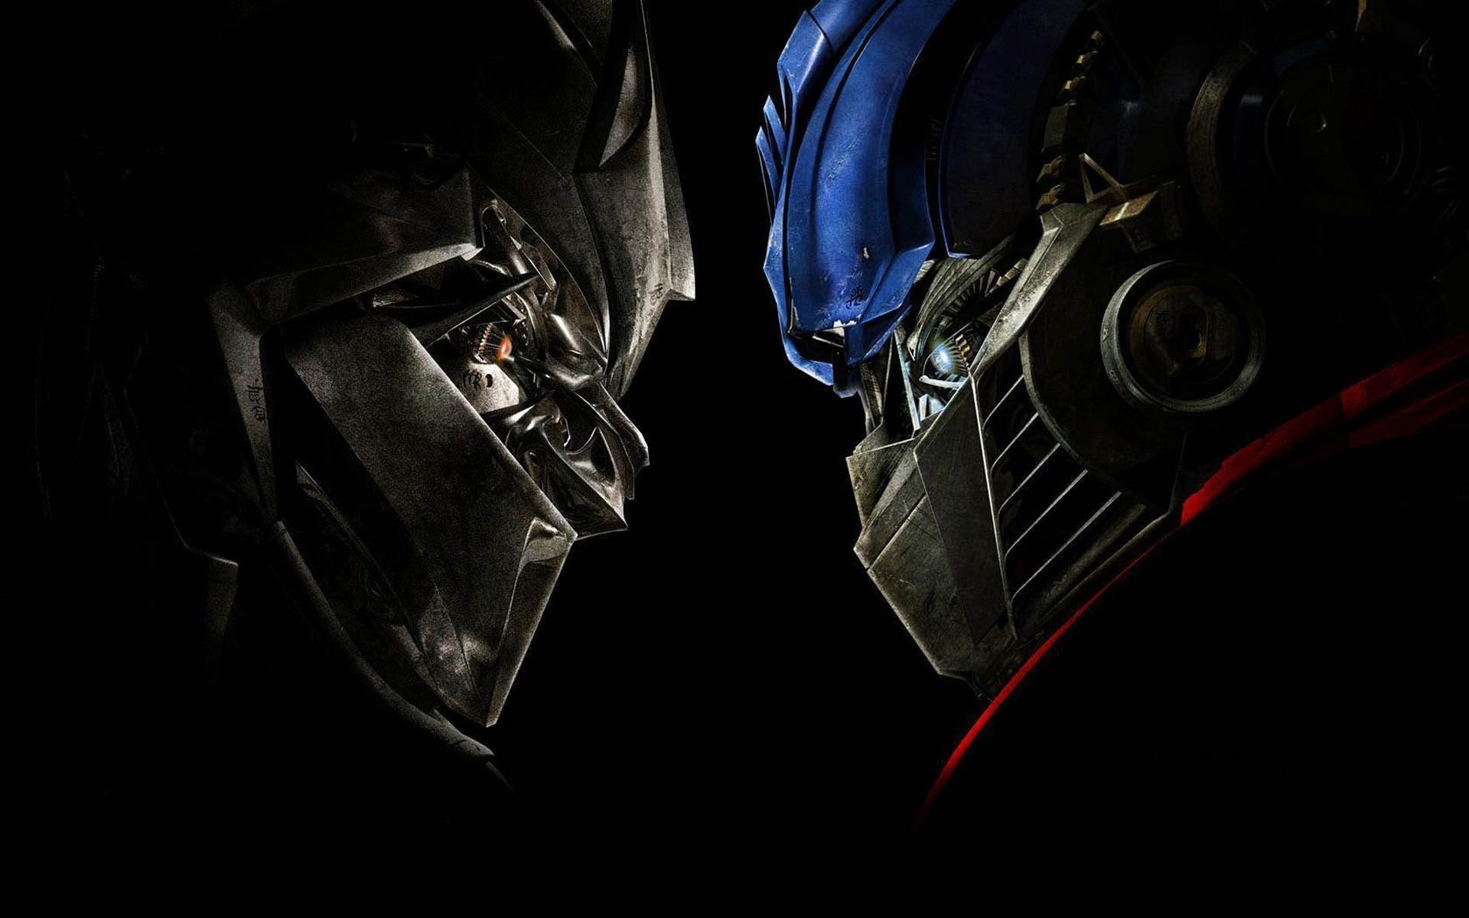
Challenge
Do Your Own Design like “DrawOut5”
Notes:
Can Demo Jade Scratch if people are interested. In doing this product I’ve had a few interesting discoveries – one was going with a simpler programming language actually has a *LOT* of value for an expert like myself.

Slide 19
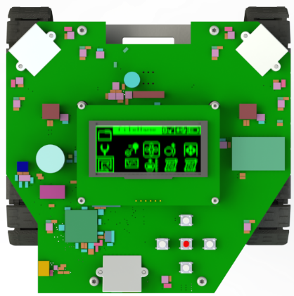
Robot Motion
Tracks Moving in
Same Direction &
Same Speed
Tracks Moving in
Different Direction
Or Different Speed
Notes:
Can Demo Jade Scratch if people are interested. In doing this product I’ve had a few interesting discoveries – one was going with a simpler programming language actually has a *LOT* of value for an expert like myself.

Slide 20
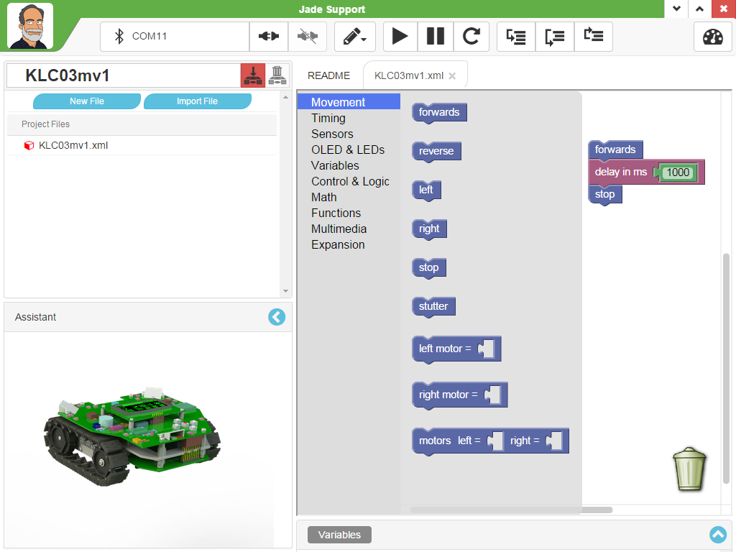
Movement Continues Until Changed
Set Individual Motor Values
-100 – Full Reverse
0 - Stop
100 – Full Forwards
Notes:
Can Demo Jade Scratch if people are interested. In doing this product I’ve had a few interesting discoveries – one was going with a simpler programming language actually has a *LOT* of value for an expert like myself.

Slide 21
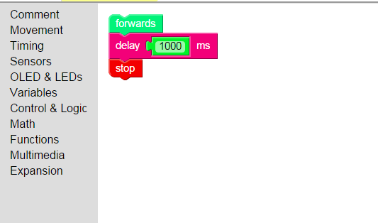
Start Robot Moving
Forwards
(Movement Toolbox)
Move for 1s
(Timing Toolbox)
Stop Robot Movement
(Movement Toolbox)
“move”
Notes:
Can Demo Jade Scratch if people are interested. In doing this product I’ve had a few interesting discoveries – one was going with a simpler programming language actually has a *LOT* of value for an expert like myself.

Slide 22
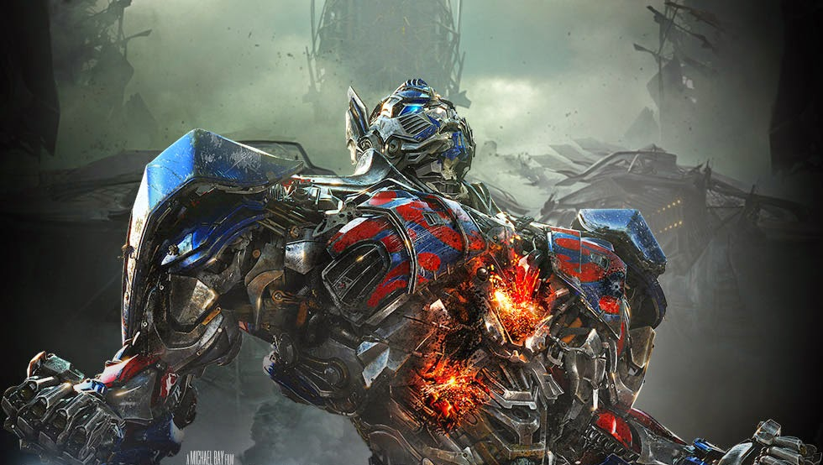
Experiment
Creat Movement Programs and Measure:
How far the Robot moves in a second
How much the Robot turns in a second
Add a Pen to the Robot and test your Programs
Notes:
Can Demo Jade Scratch if people are interested. In doing this product I’ve had a few interesting discoveries – one was going with a simpler programming language actually has a *LOT* of value for an expert like myself.

Slide 23
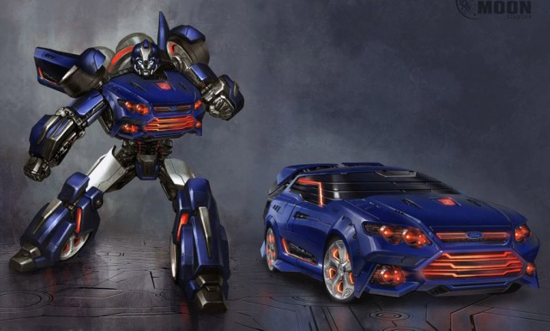
Challenge
Come up with Movement Programs That:
Draws a Letter on the Paper
Notes:
Can Demo Jade Scratch if people are interested. In doing this product I’ve had a few interesting discoveries – one was going with a simpler programming language actually has a *LOT* of value for an expert like myself.

